Slide 1
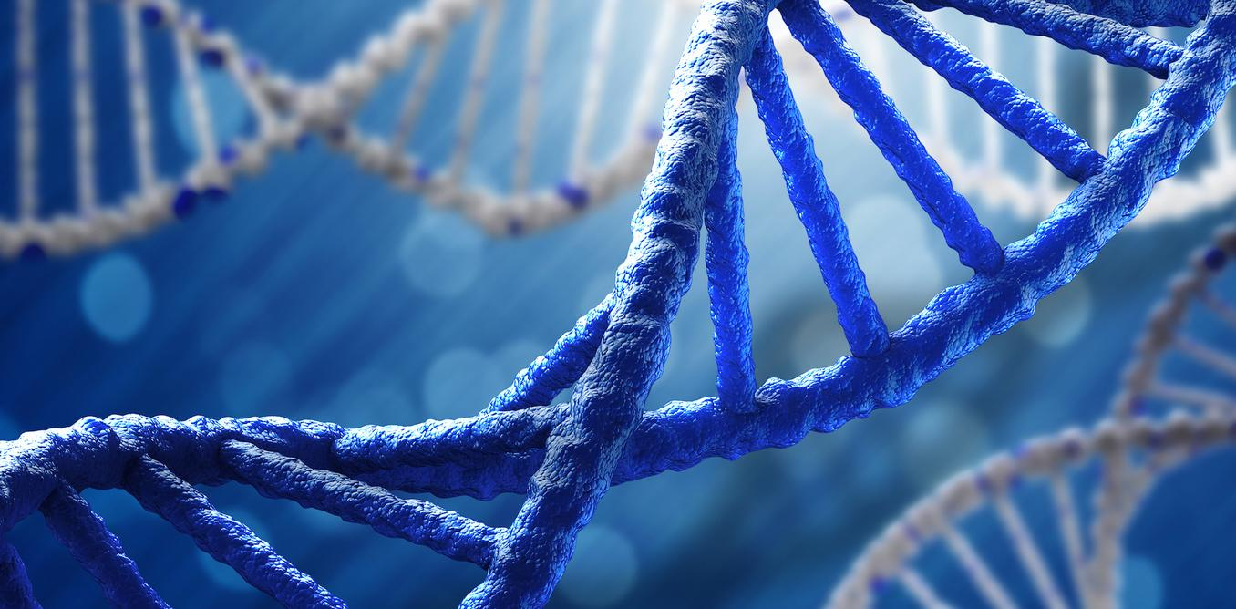
Cobham’s Thesis
& DNA Computing

Slide 2
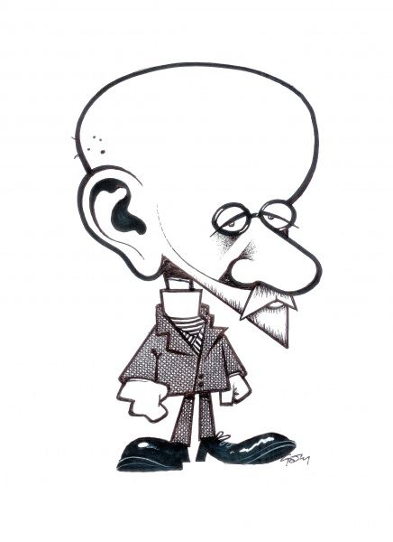
Review
In the 1920, Hilbert proposed that it should be possible to write down a finite set of axioms which could then be used to formalise all of mathematical theory without any paradoxes arising (be mathematically consistent).
This was known as Hilbert’s Program.

Slide 3
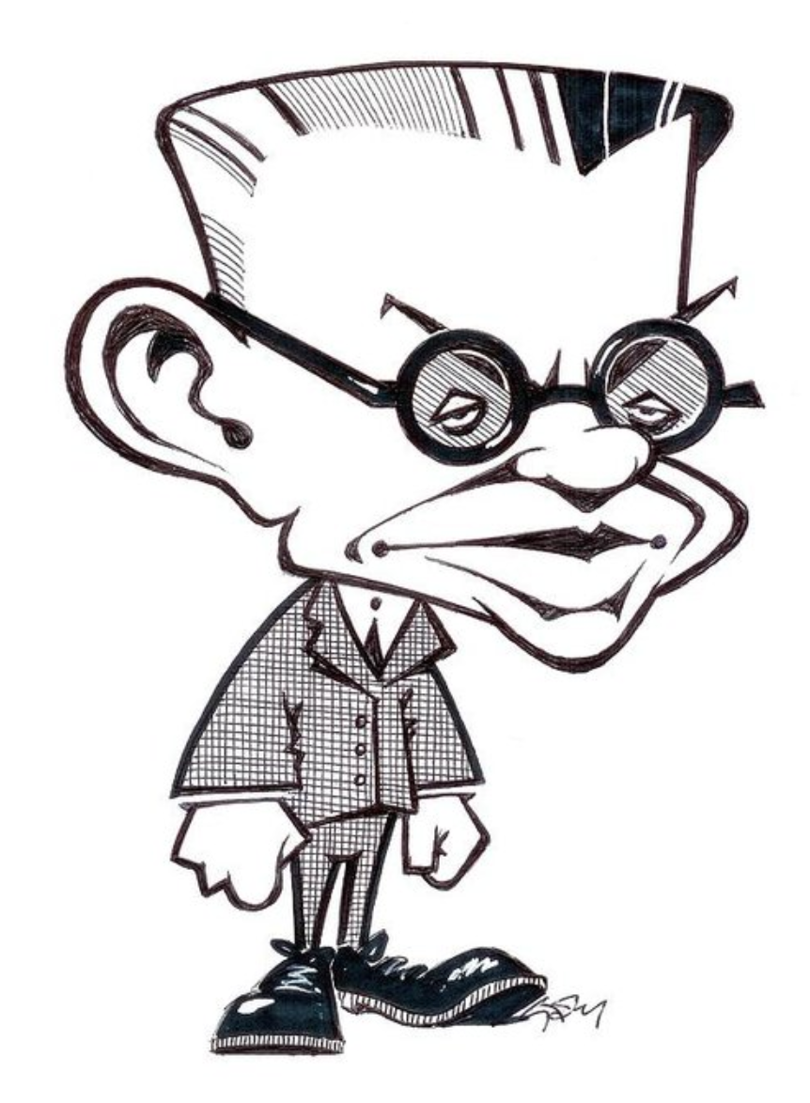
Review
In 1927, Gödel published his ‘incompleteness theorem’ that was actually made up of two proofs.
Any finite set of axioms that can be created by an algorithm cannot describe every arithmetic truth
It is not possible for a finite set of axioms to demonstrate their own consistency.

Slide 4
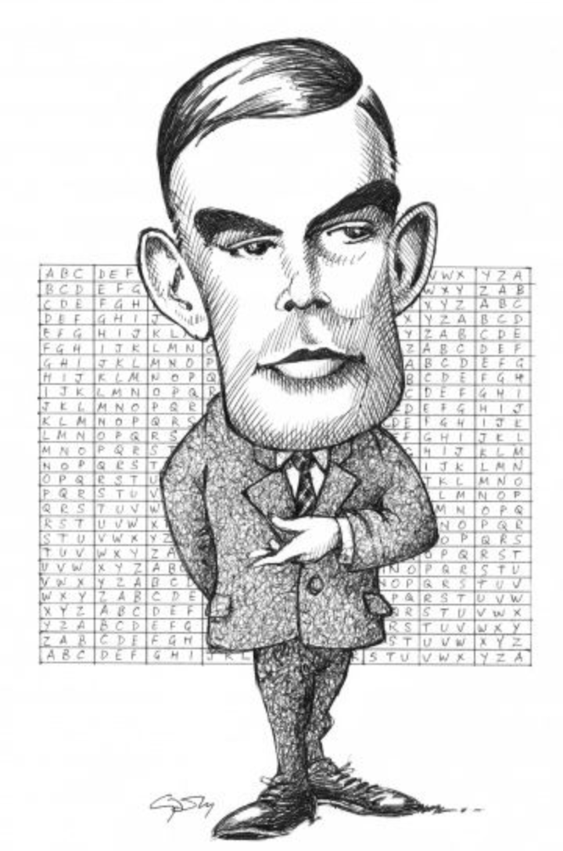
Review
In the 1930s, Alan Turing and Alonzo Church each came up with their own attempt to describe what the term computability meant.
Church developed a mathematical method for defining functions known as Lambda Calculus (λ-Calculus). A function on the natural numbers is called λ-computable if there exists a corresponding term in λ-Calculus.

Slide 5
Review
Turing Developed the idea of a Turing Machine which was a machine that could carry out calculations through the manipulation and reading of a tape of inputs.
A function is said to be Turing computable if there exists a way of using a Turing machine to compute the corresponding function.

Slide 6
Review
Church and Turing then proceeded to prove that these different attempts at defining ‘computability’ were actually all equivalent and that anything that is λ-computable is therefore also Turing computable.
This led to the Church Turing Thesis which states that any function (algorithm) can be considered computable by an (unerring) human if it is computable by a Turing Machine (ignoring resource limitations).

Slide 7
Cobham’s Thesis
But this is only one attempt to define what is computable. Cobham’s Thesis is another attempt to do so. In 1965 Alan Cobham made the assertion that a function can be defined as being feasibly computable only if it can be computed in Polynomial time.
This obviously has some limitations as a function that has a time complexity of O(n¹⁰⁰) would be considered to be computable whilst a function with a time complexity of O(2^{0.000001n}) would be considered not despite the fact that when comparing the two, the O(n¹⁰⁰) algorithm would be impractical for n=2 and the O(2^{0.000001n}) algorithm would be easily solved for n=1,000,000.
Still, Cobham’s Thesis provides an alternate way to think about what is feasibly computable (Tractable) and what is not.

Slide 8
Cobham’s Thesis
While Gödel’s incompleteness theorem and Turing’s undecidable halting problem demonstrated a “hard” upper limit to what is computable, Cobham’s thesis provided a “soft” limit to what is practically computable.
Cobham’s thesis was proposed before the advent of formal computational complexity analysis and the P vs NP problem, though he essentially defined the P class of problems.
We now have additional formal tools to better quantify tractability.

Slide 9
Hilbert’s Program
1920
1927
Godel’s Incompleteness Theorem
1930
Turing’s Machine
Church’s Lambda Calculus
Halting Problem
…….
1965
Cobham’s Thesis
1971
P vs NP

Slide 10
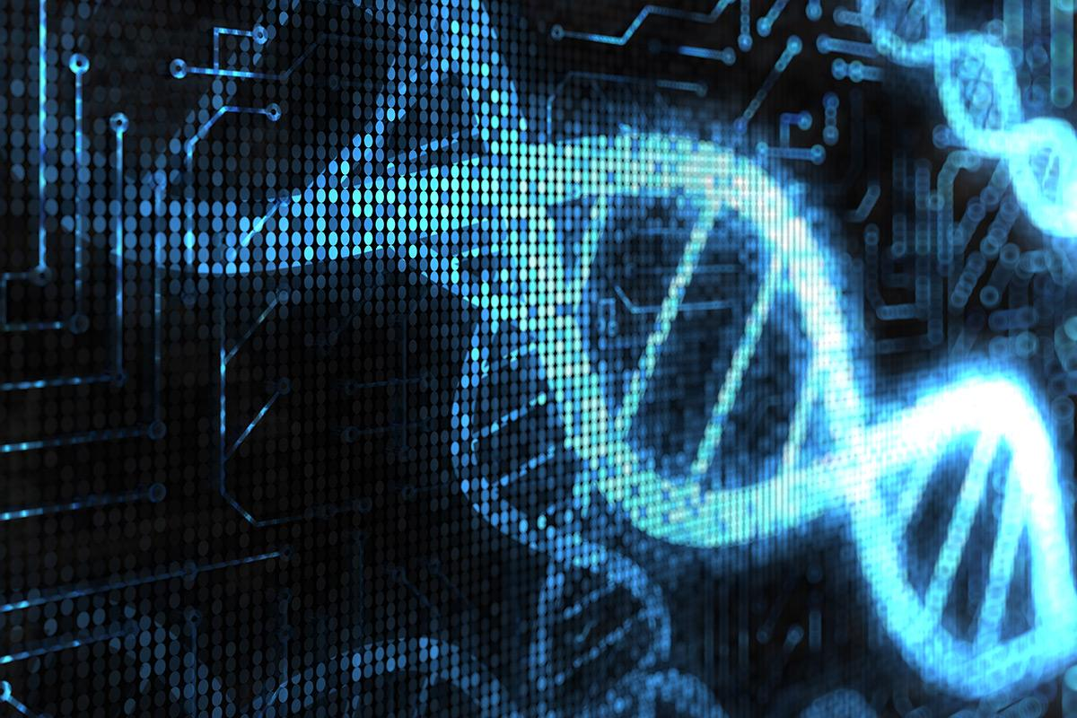
DNA Computing

Slide 11
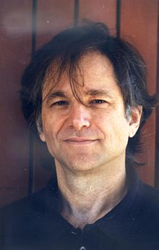
DNA Computing
Read the article from Scientific American:
Computing with DNA by Leonard M. Adleman
Make a summary set of notes about the processes involved in using DNA to perform the specific calculation in question.
Next lesson, we will go over this in detail and identify exactly what you need to know about DNA Computing and the implications that this alternate form of computing has on the computability of problems.

